Slide 1

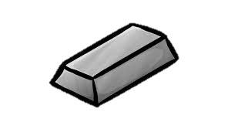
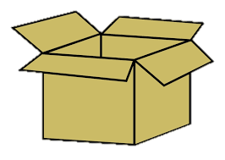
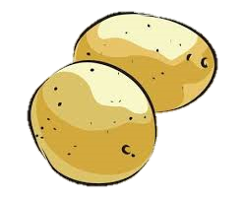




Identifying Industry Clusters in the Scottish Economy

Slide 2
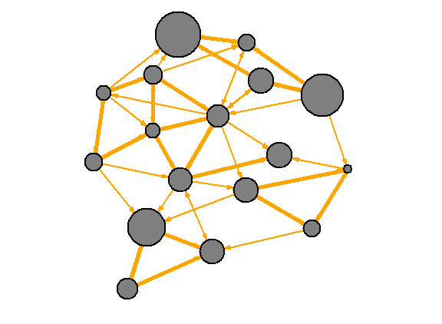
Understanding Network Analysis What is a network?
Understanding Network Analysis What is a network?
A network is a group of data points (called nodes) connected by links (called edges).
Depending on the type of data being represented, edges possess different properties.
They can represent:
A simple connection, such as in a social network.
A directed connection, where information flows in a set pattern from A to B.
A weighted connection, which represents the amount a node adds or subtracts to the node it is connected to.
A network can consist of a combination of these different types of edges.

Slide 3
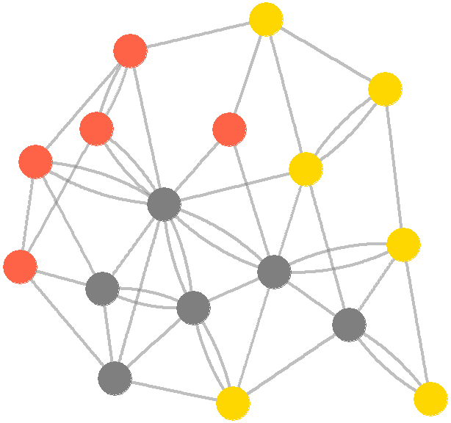
Network Clustering
Clustering can be described as grouping nodes that have more in common with each other than the rest of the network.
To achieve this there are a plethora of clustering algorithms to choose from.
Naturally, most algorithms differ in their definition of what a cluster is, and how to best detect them.

Slide 4
Why Find Clusters?
Our usual analysis gives us a large-scale image of how each individual industry is performing.
E.g.: “The Transport Equipment sector has grown 0.4% since the last quarter.”
Through clustering we can garner a more granular, medium-level view of the economy.
This would help us build a narrative about broad structural changes and how it may affect industries related or dependent on each other.
E.g.: “The Energy Sectors are showing solid growth” or “There are persistent weaknesses across Transportation”.
If there’s a big change in one component of a cluster – that’s a big warning sign for the rest of the industry.

Slide 5
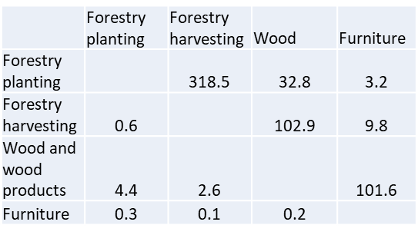
What About the Economy?
The inner functioning of the Scottish Economy is modelled using Input-Output tables, a matrix of how much each economy sector contributes to each other.
There are two main types of IO tables: the Industry-by-Industry table, and the Leontief table.
Industry-by-Industry tables measure the output of each sector in terms of millions of pounds (£).
Leontief (Type 1) tables measure output in terms of units of production.
For our current model, we are using a Leontief table.

Slide 6
The matrix as a graph
Example – The 4 x 4 table is just another representation of the graph on the right
We can interpret this matrix as a network, where each sector is a node.
Each cell value is the edge size between two nodes.
 | Forestry planting | Forestry harvesting | Wood | Furniture
Forestry planting |  | 318.5 | 32.8 | 3.2
Forestry harvesting | 0.6 |  | 102.9 | 9.8
Wood and wood products | 4.4 | 2.6 |  | 101.6
Furniture | 0.3 | 0.1 | 0.2
Forestry
Planting
Forestry
Harvesting
Furniture
Wood
The full Leontief table (after we take out the isolated sectors) is 95 x 95

Slide 7

Recap: Anatomy of a network
Graph A description of a network
Node
An object in the graph
A connection between two nodes (can have a weight/direction)
Edge
A grouping of nodes that are more connected to each other than other nodes.
Cluster

Slide 8
How to Measure Clustering
So, how do we measure clustering?
While there are a variety of measurements, only a few are suitable for a weighted, directed network such as ours.
A popular measurement for weighted, directed networks is Louvain Modularity, a fast-greedy algorithm using the modularity measurement.
Although there is no perfect measurement of how good a cluster is modularity is a useful one, as it is (relatively) simple and fast to calculate.

Slide 9
Modularity – a Measure of Clustering
Modularity is expressed as a fraction, ranging between -1 to 1, and is calculated using the formula below.
-
(
)
2
Sum of all edges in cluster
Sum of all edges between cluster and other nodes
2 x sum of all edges
2 x sum of all edges

Slide 10
Calculating Change in Modularity
In practice we do not start with the right clusters – we need a way to find them
Change in modularity (delta Q) is the way to do this. Calculate the total modularity of the graph, and then calculate the modularity of the graph after a cluster has been build.
Go through all possible cluster for each node and find what gives the maximum total modularity score, and assign it to the cluster.
A lot of number crunching! Luckily we have statistical language designed explicitly for exactly that.

Slide 11

Change in Modularity
Equation for calculating modularity change – don’t panic, diagrams next slide
Calculate the Modularity (Q) of the graph you would get if the node you’re interested in (i) were to be moved into a particular cluster (C)
Then subtract the Q of the graph if the two were kept separate.
This gives you the delta Q – the change in modularity if you made this change
Go through all possible communities for each node and find what gives the maximum total modularity score

Slide 12
Sum of links in
new cluster
Sum of links
from old cluster
and links from
node
Sum of links in
old cluster
Sum of links from node
to be added to old cluster
Sum of links from
old cluster

Slide 13
Running the Louvain algorithm
The Louvain algorithm calculates delta Q for smaller clusters by optimizing modularity on individual nodes, then each small clusters is grouped with one connected node and the first step is repeated.
For each node – calculate the delta Q of adding it to every possible cluster (a cluster can just be another node)
Find the set of clusters that create the highest possible delta Q – rebuild the graph using them
Repeat step 1 and 2 until it is no longer possible to increase the modularity of the graph
The algorithm ends – with every node classified as belonging to a cluster (although that cluster may only contain itself)

Slide 14
And Now What?
The initial results were interesting to say the least.
7 clusters, where one cluster was 42% of all nodes, two were circa 20%, and the remaining 4 contained 6 or fewer nodes.
One of the limitations of how modularity operates is how it compares a cluster to the null model.
The number of edges inside a cluster is compared with with the expected number of edges in the cluster if the network was a random network of the same size with randomly attached edges.
This assumption does not scale with network size, as the number of edges between to clusters decreases as network size increases, meaning we eventually approach an edge approximation smaller than one.
Thus, we end up with unrealistically large clusters, containing a large amount of nodes with notably weak edge weights.
Can we break up these bigger clusters into more sensible units?
Yes we can, thanks to the addition of a resolution parameter!
Simply put, a parameter that controls the relative importance of edges inside a cluster when compared with the null model, to avoid underweighting.

Slide 15
We Run the Louvain Algorithm on the Leontief Table
“There’s a library for that” – install.packages(“networktoolbox”)
Results: every industry now classified into approximately 16 reasonably logical clusters!
Some interesting results that make sense on reflection: beer is tightly linked to metal working, since they require so much canning and brewing containers.
But also some spurious results. A few sectors fit very weakly into their clusters.
Unfortunately the networktoolbox package doesn’t provide data on the strength of an association

Slide 16
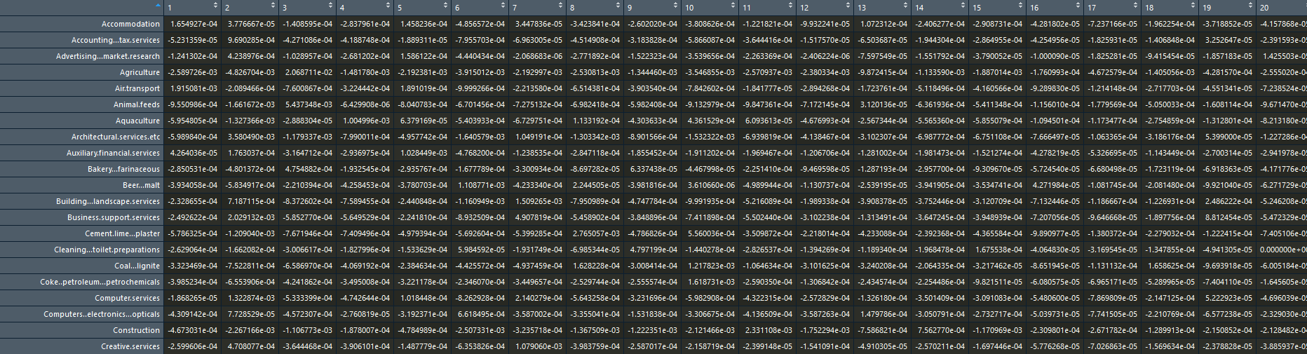
Examining the Clusters in More Depth
Re-code Louvain’s delta Q equation, so that it outputs the modularity score for each cluster/sector pair, rather than telling you the max
Use expert judgement to decide on a final set of cluster

Slide 17
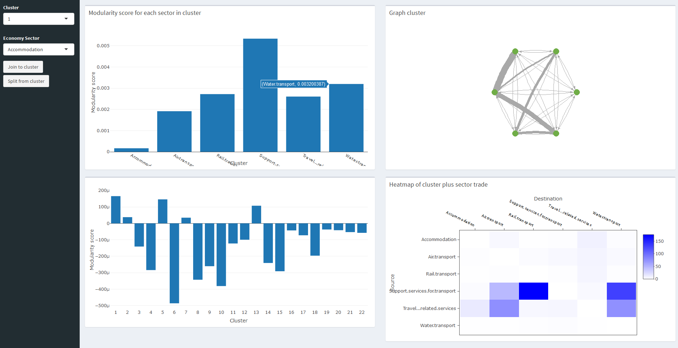
Accommodation is very tenuously placed in Cluster 1 – and should be treated with great care.

Slide 18
Sixteen Consistent Clusters
Transport
Business support services
Food production
Offshore
Communications
Metal products
Leisure activities
Construction materials
Rubber and plastic
Energy
Construction
Finance and real estate
Health
Wood products
Printing
Clothes

Slide 19
Sixteen Consistent Clusters
Headline results
+60% | In 2019 Q1 industries in the financial & real estate cluster contributed 60% of the total growth to GDP
+20% | In 2019 Q1 growth in industries in the business support cluster contributed 20% of the total growth to GDP
-20% | In 2019 Q1, contraction in industries in the energy cluster lowered total GDP growth by 20%

Slide 20
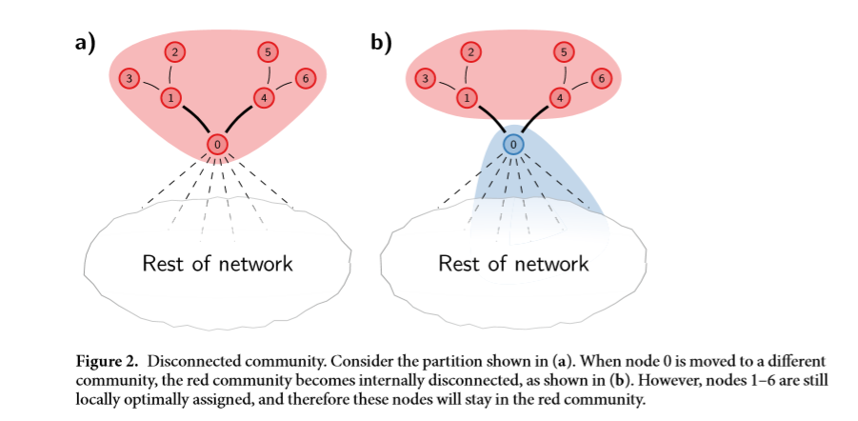
Alternative Algorithms
While the results from the Louvain algorithm have allowed us greater insight into the Scottish economy, it is not without limitations.
Traag, Waltman, and Van Eck (2018) point out that the Louvain algorithm can randomly produce poorly connected clusters, due to it’s fast-greedy design.
In worst case scenarios, clusters may even be disconnected, especially running several iterations.
While we have no results to show yet, we are currently working on clustering our IO tables using the Leiden algorithm

Slide 21
References
Detailing the mathematical underpinnings of Louvain clustering:
Blondel, V. D., Guillaume, J. L., Lambiotte, R., & Lefebvre, E. (2008). Fast unfolding of communities in large networks.
Introducing the parameter of resolution to the clustering method:
Rubinov, M., & Sporns, O. (2010). Complex network measures of brain connectivity: Uses and interpretations.
Introducing the Leiden algorithm
Traag, V.A., Waltman. L., Van Eck, N.-J. (2018). From Louvain to Leiden: guaranteeing well-connected communities.

